Slide 1
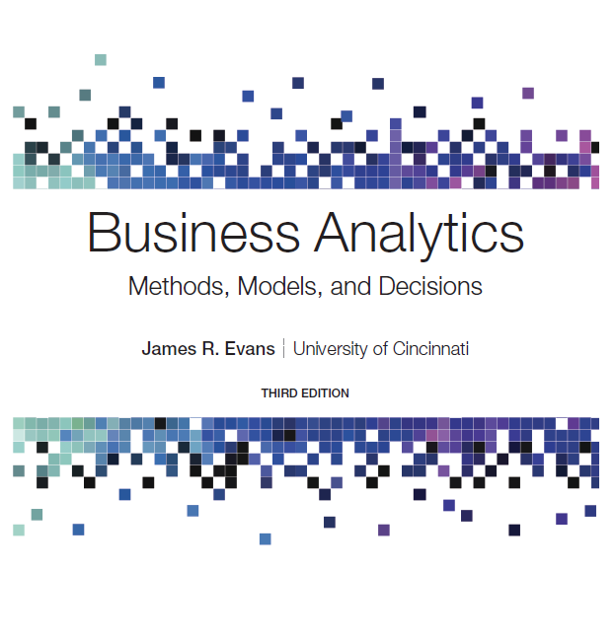
Business Analytics: Methods, Models, and Decisions
Third Edition
Chapter 12
Simulation and Risk Analysis
Copyright © 2020, 2016, 2013 Pearson Education, Inc. All Rights Reserved
Notes:
If this PowerPoint presentation contains mathematical equations, you may need to check that your computer has the following installed:
1) MathType Plugin
2) Math Player (free versions available)
3) NVDA Reader (free versions available)

Slide 2
Risk Analysis
Risk is the likelihood of an undesirable outcome. It can be assessed by evaluating the probability that the outcome will occur along with the severity of the outcome.
Risk analysis seeks to examine the impact of uncertain inputs on various outputs.

Slide 3
Monte Carlo Simulation
Monte Carlo simulation is the process of generating random values for uncertain inputs in a model, computing the output variables of interest, and repeating this process for many trials to understand the distribution of the output results.
We model uncertain inputs using probability distributions, using historical data, or choosing a representative distribution judgmentally.
Monte Carlo simulation relies on generating values from these distributions to create a probability distribution of output values.

Slide 4
Example 12.1: Profit Model
Demand, unit cost, and fixed cost are uncertain.
Historical demand:
Demand | Probability
40,000 | 0.1
45,0000 | 0.3
50,000 | 0.4
55,000 | 0.15
60,000 | 0.05
Unit cost varies between $22 and $26; use a uniform distribution.
Fixed cost low as $350,000 or as high as $500,000, with the most likely value being $400,000; use a triangular distribution.

Slide 5
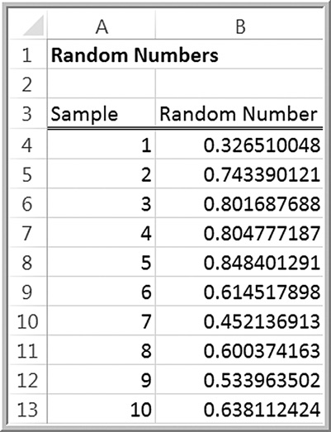
Random Sampling from Probability Distributions
In the context of simulation, random numbers are numbers that are uniformly distributed between 0 and 1.
In Excel, we may generate a random number that is greater than or equal to 0 and less than 1 within any cell
using the function
Whenever any cell in the spreadsheet is modified, the values in any cell
containing the
function will
change.

Slide 6
Sampling from Common Probability Distributions
A value randomly generated from a specified probability distribution is called a random variate.
Analysis Toolpak Random Number Generation Tool
Can sample from uniform, normal, Bernoulli, binomial, Poisson, patterned, and discrete distributions.
Can also specify a random number seed - a value from which a stream of random numbers is generated. By specifying the same seed, you can produce the same random numbers at a later time.

Slide 7
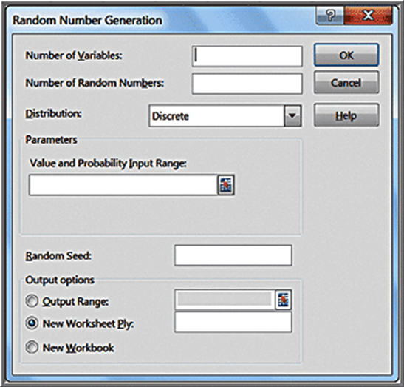
Example 12.2: Using Excel’s Random Number Generation Tool (1 of 2)
Generate 100 outcomes from a Poisson distribution with a mean of 12
Number of Variables = 1.
Number of Random Numbers = 100
Distribution = Poisson
Dialog changes and prompts you to enter Lambda (mean of Poisson) = 12

Slide 8
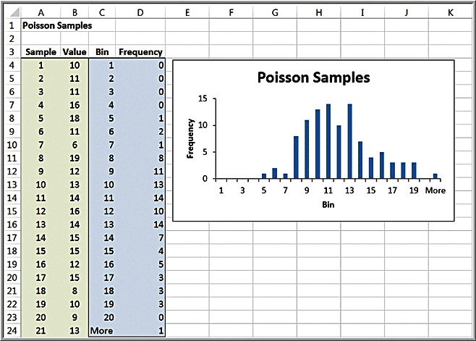
Example 12.2: Using Excel’s Random Number Generation Tool (2 of 2)
(Histogram created manually.)
One disadvantage with using the Random Number Generation tool is that you must repeat the process to generate a new set of sample values. This can make it difficult to use this tool for simulation models.

Slide 9
Generating Random Variates Using Excel Functions
We may use Excel functions to generate random variates for many common types of probability distributions.
This allows us to replace uncertain input data cells in a model with random variates.

Slide 10
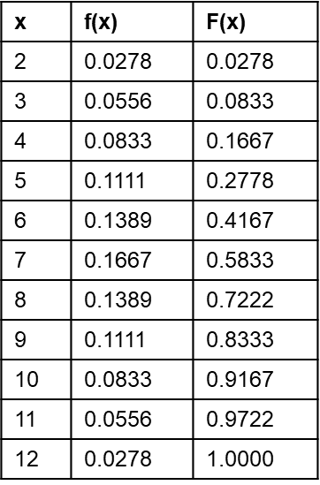
Example 12.3: Sampling from the Distribution of Dice Outcomes
Interval | Outcome
≥ 0 and < 0.0278 | 2
≥ 0.0278 and < 0.0833 | 3
≥ 0.0833 and < 0.1667 | 4
≥ 0.1667 and < 0.2778 | 5
≥ 0.2778 and < 0.4167 | 6
≥ 0.4167 and < 0.5833 | 7
≥ 0.5833 and < 0.7222 | 8
≥ 0.7222 and < 0.8323 | 9
≥ 0.8323 and < 0.9167 | 10
≥ 0.9167 and < 0.9722 | 11
≥ 0.9722 and < 1.000 | 12
The values of
divide the interval from 0 to 1 into smaller intervals that
correspond to the probabilities of the outcomes. To generate an outcome from this distribution, all we need to do is to select a random number and determine the interval into which it falls.

Slide 11
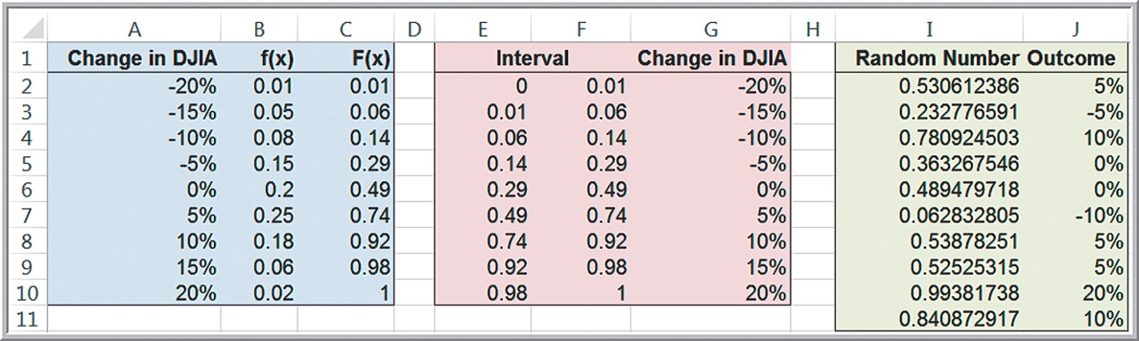
Example 12.4: Using the VLOOKUP Function for Random Variate Generation
Sample from the probability distribution of the predicted change in the Dow Jones Industrial Average index.
The formula in cell
which is copied down that column.

Slide 12
Uniform Distributions
Transform a random number into a random variate from a uniform distribution between a and b.

Slide 13
Example 12.5: Modeling Uncertainty with a Uniform Random Variate
The uniform distribution is often used when little is known about the distribution of an uncertain variable.
Suppose that a supplier states that the price might be as low as $42 or as high as $50 per unit.
If RAND generates the random number 0.6200, then
the price would be

Slide 14
Exponential Distributions
Exponential random variates can be generated easily using the Excel formula
where
is the mean of the exponential
distribution, and L N is the Excel function for the natural logarithm.

Slide 15
Normal Distributions
Normal random variates can be generated in Excel using inverse functions. Inverse functions find the value for a distribution that has a specified cumulative probability.
generates a random variate from a normal distribution with a specified mean and standard deviation.
generates a random variate
from a standard normal distribution (mean = 0 and variance = 1).

Slide 16
Example 12.6: A Sampling Experiment for Evaluating Capital Budgeting Projects (1 of 2)
In finance, one way of evaluating capital budgeting
projects is to compute a profitability index:
P V is the present value of future cash flows.
I is the initial investment.
What is the probability distribution of P I when P V is estimated to be normally distributed with a mean of $12 million and a standard deviation of $2.5 million, and the initial investment is also estimated to be normal with a mean of $3.0 million and standard deviation of $0.8 million?

Slide 17
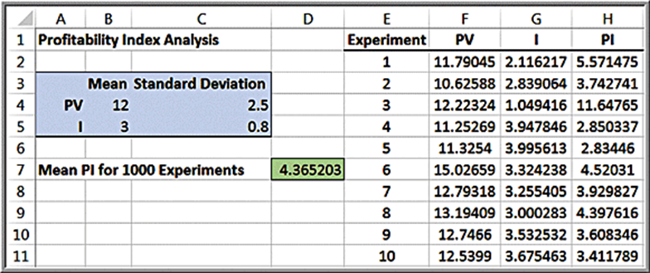
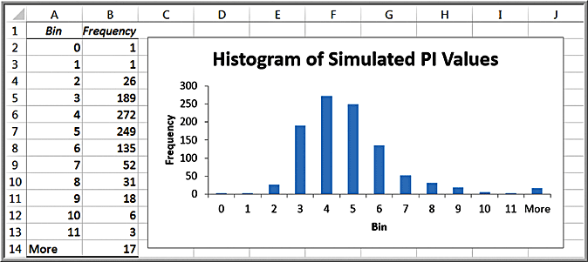
Example 12.6: A Sampling Experiment for Evaluating Capital Budgeting Projects (2 of 2)
Column F:
Column G:

Slide 18
Binomial Distributions
To generate a random variate from a binomial distribution, we may use the Excel function
This function finds
the smallest value for which the cumulative binomial distribution is greater than or equal to alpha.
To randomly generate a binomial random variate,
replace alpha with
that is,

Slide 19
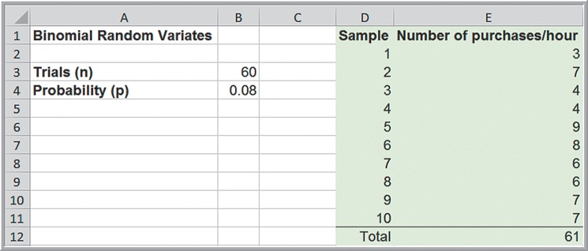
Example 12.7: Binomial Random Variates
Sixty potential customers are called each hour by a telemarketer. The probability that any of them will make a purchase is 0.08. Over a ten-hour period, how many customers might make a purchase?
Ten samples result in 61 purchases, or 6.1 per hour.
Since the mean of the binomial is np = 4.8, over a ten-hour period, we would expect 48 successes. A larger number of samples would average closer to 4.8.

Slide 20
Triangular Distributions
The triangular distribution depends on three parameters, a = minimum, b = maximum, and c = most likely.
A triangular random variate, X, can be generated using one of the following formulas that depend on the value of R (R is a random number):

Slide 21
Using Excel for Triangular Random Variates
First generate a random number R and compute
then use the first formula to generate X;
otherwise, use the second formula.
Excel formula:
Caution: You cannot replace the
since they must all be the same random number. Therefore, in an application, R must be referenced from a cell outside of this formula.

Slide 22
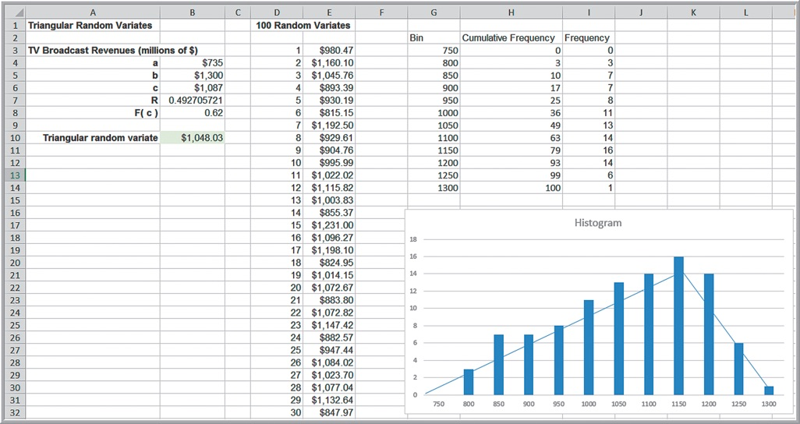
Example 12.8: Using the Triangular Distribution for a U.S. Olympic Bid Risk Assessment
Excel file Triangular Random Variates
The spreadsheet also shows a table with 100 samples from the distribution.

Slide 23
Monte Carlo Simulation in Excel
Develop a spreadsheet model.
Determine probability distributions for uncertain input variables.
Identify output variables you want to evaluate.
Choose the number of trials (replications) for the simulation.
Create a data table to summarize the values of the model output for the replications.
Compute summary statistics, percentiles, confidence intervals, frequency distributions, and histograms to interpret the results.

Slide 24
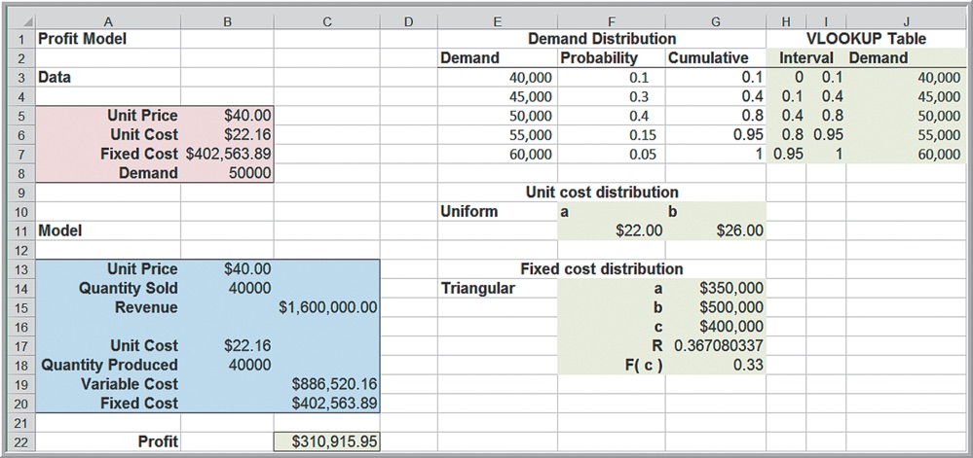
Example 12.9: Setting Up the Monte Carlo Simulation Model for the Profit Model
Refer to Example 12.1

Slide 25
Running a Simulation
To perform the simulation, we need to generate a sufficient number of trials, or replications, to obtain enough data to create a reasonable distribution of the model output values.
In Excel, we can generate several hundred replications using data tables.

Slide 26
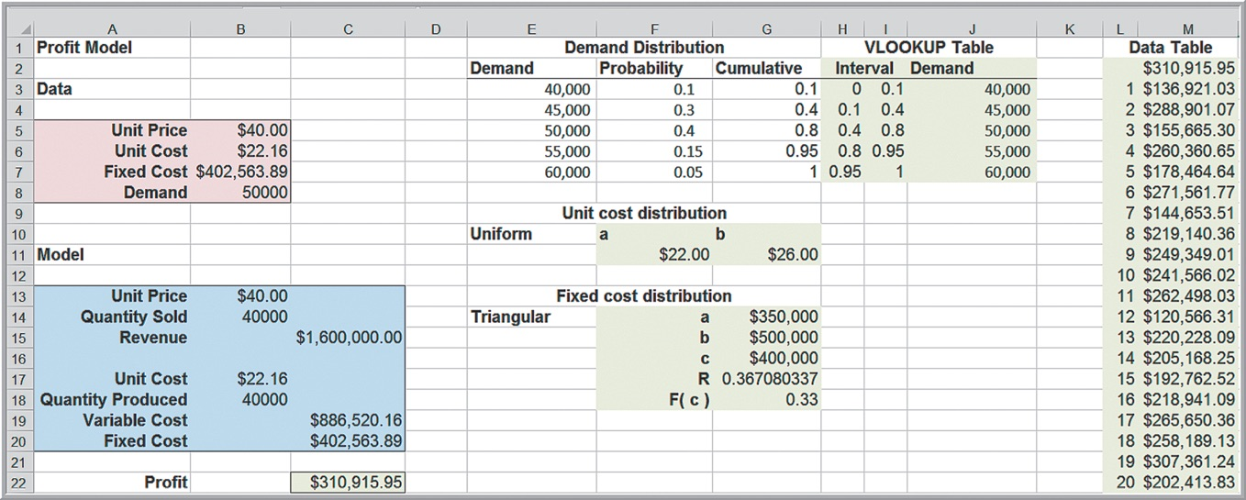
Example 12.10: Using Data Tables and Analyzing Results for Monte Carlo Simulation in Excel (1 of 2)
Create a data table to replicate the simulation for the model output. List the trials (column L). Reference cell C22 in cell M2. In the Column Input Cell field in the Data Table dialog, enter any blank cell in the spreadsheet (Excel file Profit Model Monte Carlo Simulation)

Slide 27
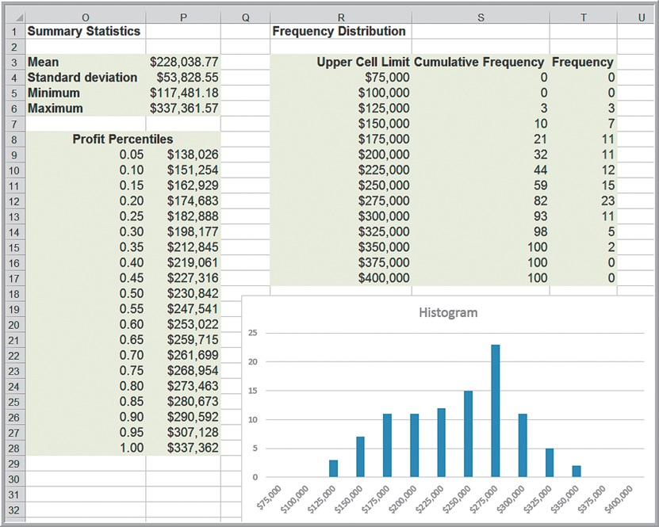
Example 12.10: Using Data Tables and Analyzing Results for Monte Carlo Simulation in Excel (2 of 2)
Analyze results.
Compute summary statistics, percentiles, and a frequency distribution and histogram. (To find the frequency distribution, we used COUNTIF functions to find the cumulative frequencies, and then found the number of observations in each cell by subtraction.)

Slide 28
Using the FREQUENCY Function
An easier alternative to compute a frequency distribution is
to use the Excel function
This is an “array” function and returns values in a range of cells.
When you enter an array formula, you must first select the range in which to place the results. Then, after entering the formula, you must press Ctrl+Shift+Enter in Windows or Command+Shift+Enter on a Mac simultaneously.

Slide 29
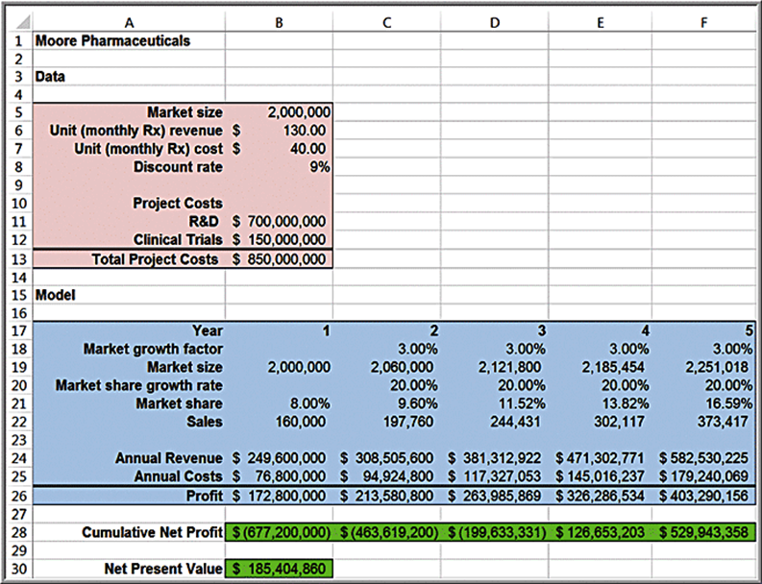
New Product Development
Moore Pharmaceuticals spreadsheet. With uncertain data:
What is the risk that the net present value over the 5 years will not be positive?
What are the chances that the product will show a cumulative net profit in the third year?
What minimum cumulative profit in the fifth year are we likely to achieve with a probability of at least 0.90?

Slide 30
Model Assumptions
Market size: normal with mean of 2,000,000 units and standard deviation of 400,000 units
R&D costs: uniform between $600,000,000 and $800,000,000
Clinical trial costs: normal with mean of $150,000,000 and standard deviation $30,000,000
Annual market growth factor: triangular with minimum = 2%, maximum = 6%, and most likely = 3%
Annual market share growth rate: triangular with minimum = 15%, maximum = 25%, and most likely = 20%

Slide 31
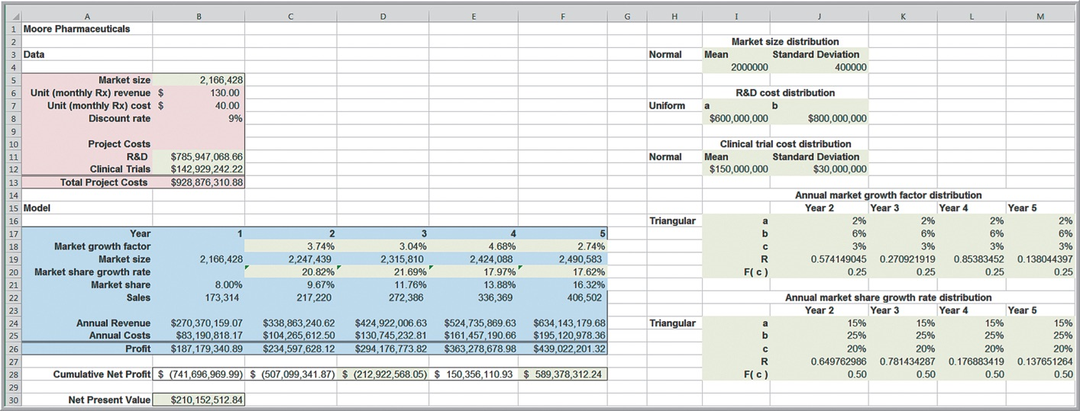
Example 12.11: A Simulation Model for Moore Pharmaceuticals (1 of 3)
Excel file Moore Pharmaceuticals Excel Simulation Model
For the annual market growth factor and annual market share growth rate in each year we have to use a different random number for each of the triangular distributions.

Slide 32
Example 12.11: A Simulation Model for Moore Pharmaceuticals (2 of 3)
Define the cumulative net profit in the third year (cell D28), the cumulative net profit in the fifth year (cell F28), and the net present value (cell B30) as the model outputs of interest.
Create three data tables, one for each output to conduct the simulation.
Use 500 trials. To do this more efficiently, we can use two-way data tables. In the Data Table dialog, enter any blank cell for both the Row Input Cell and Column Input Cell.

Slide 33
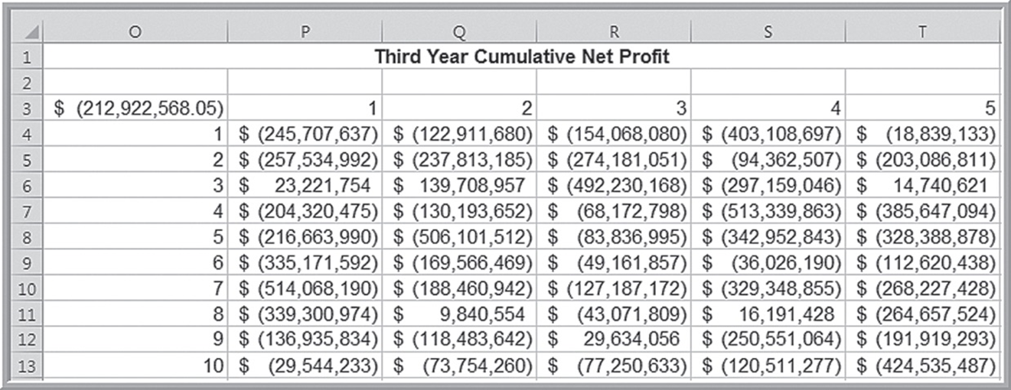
Example 12.11: A Simulation Model for Moore Pharmaceuticals (3 of 3)
Portion of Data Table Simulation

Slide 34
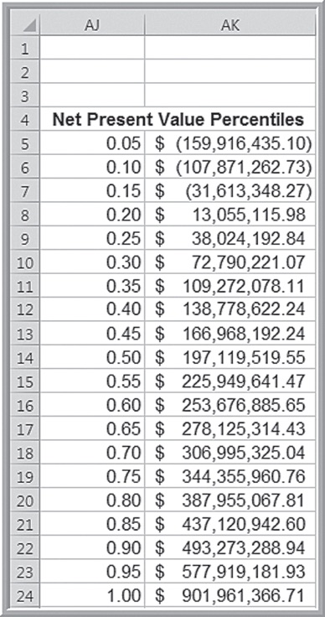
Example 12.12: Risk Analysis for Moore Pharmaceuticals (1 of 3)
What is the probability that the net present value over the five years will not be positive?
The probability that the net present value will not be positive is somewhere between 0.15 and 0.20.

Slide 35
Example 12.12: Risk Analysis for Moore Pharmaceuticals (2 of 3)
What are the chances that the product will show a positive cumulative net profit in the third year?
The probability of a positive cumulative net profit in the third year is less than 10%.

Slide 36
Example 12.12: Risk Analysis for Moore Pharmaceuticals (3 of 3)
In the fifth year, what minimum amount of cumulative profit are we likely to achieve with a probability of at least 0.90?
The 10th percentile is about $160 million.

Slide 37
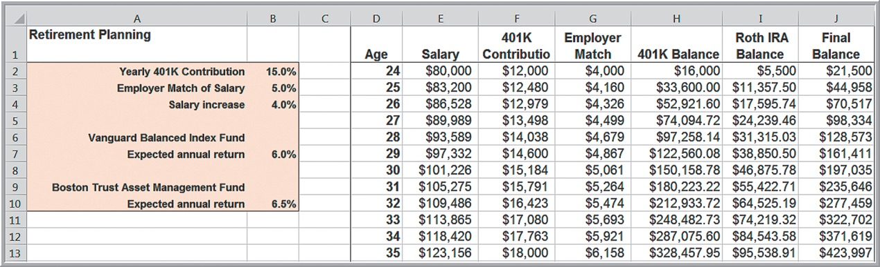
Retirement Planning
The model developed in Chapter 11 was based on some unrealistic assumptions that the annual salary increase and expected annual investment returns are constant for each year.
These values will typically change each year and investment returns may not necessarily have a positive return each year.

Slide 38
Example 12.13: Retirement Planning Model Monte Carlo Simulation (1 of 4)
Assumptions:
Annual salary increase may vary from 2% to 5%, uniformly distributed.
Data on the Vanguard Balanced Index Fund show that the average recent return is about 6%, but that it also has a standard deviation of 6.5% (normal distribution).
For the Boston Trust Asset Management Fund, the average return is about 6.5% with a standard deviation of 7% (normal distribution).
Create new columns to generate random values for the annual salary increase and investment returns.

Slide 39
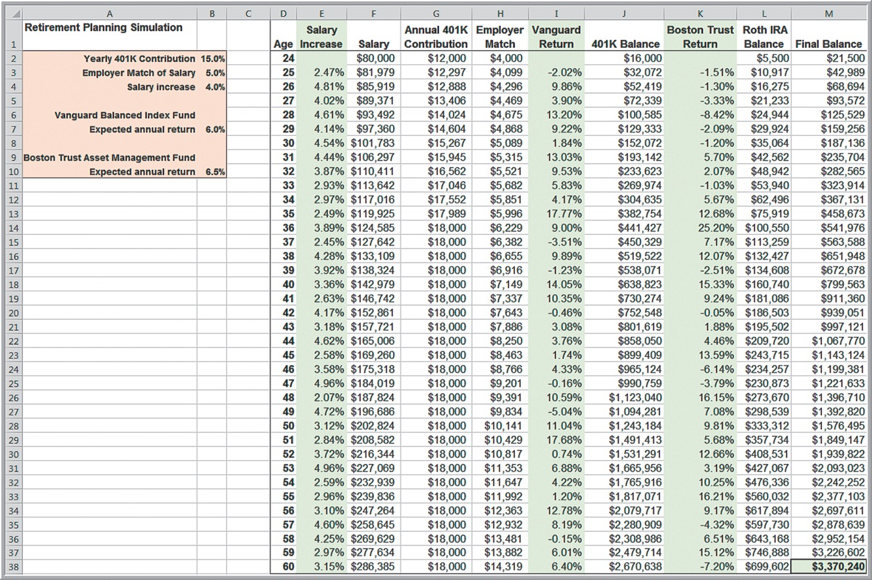
Example 12.13: Retirement Planning Model Monte Carlo Simulation (2 of 4)

Slide 40
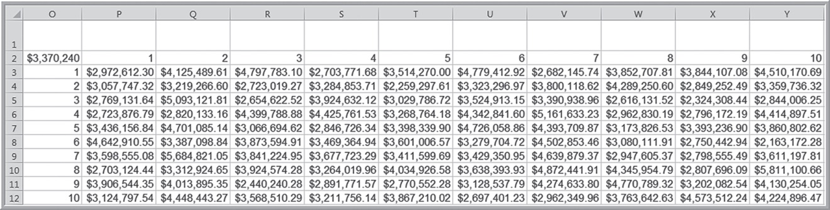
Example 12.13: Retirement Planning Model Monte Carlo Simulation (3 of 4)
Portion of data table for retirement balance.

Slide 41
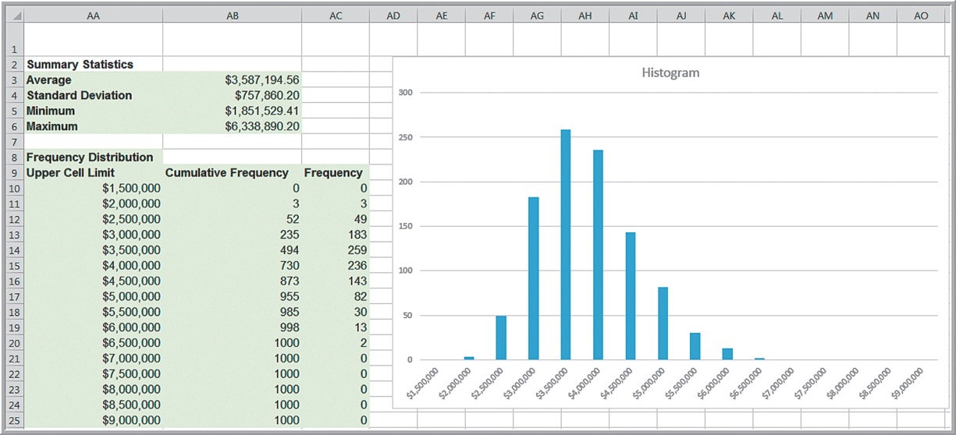
Example 12.13: Retirement Planning Model Monte Carlo Simulation (4 of 4)
Statistical analysis and risk calculations
The probability that it will be greater than $3 million but
less than 4.5 million is

Slide 42
Single-Period Purchase Decisions: Newsvendor Model
In the newsvendor model, demand will not be known and can be modeled by some probability distribution.
The decision problem that a seller faces is determining the best purchase quantity to maximize the expected net profit.
We may use Monte Carlo simulation to find the distribution of the net profit for any purchase quantity, and then use the model to find the best purchase quantity.

Slide 43
Example 12.14: A Prescriptive Simulation Model for a Single-Period Purchase Decision (1 of 4)
Historical data
Construct an empirical probability distribution and use this to simulate the demand using a lookup table.
Historical | Candy Sales
42 | 47
45 | 41
40 | 41
46 | 45
43 | 51
43 | 43
46 | 45
42 | 42
44 | 44
43 | 48

Slide 44
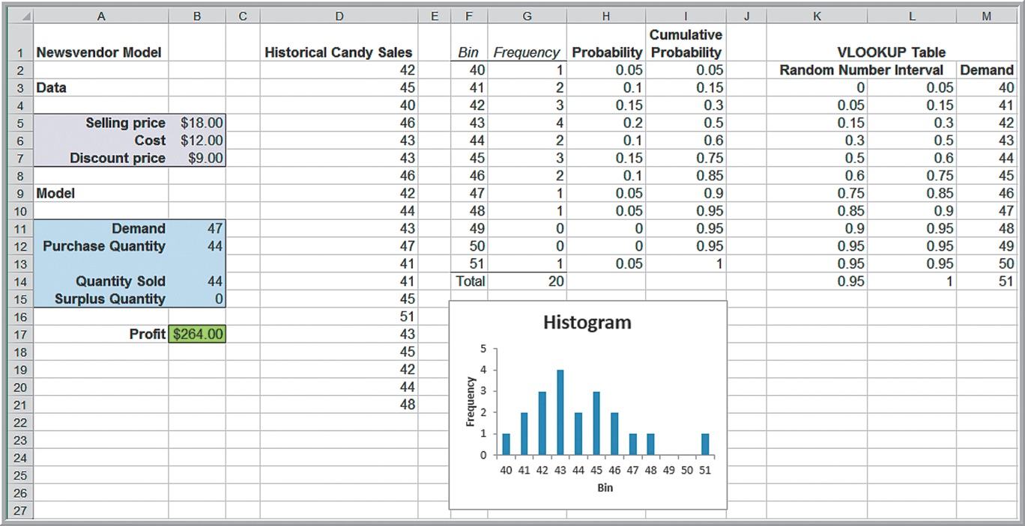
Example 12.14: A Prescriptive Simulation Model for a Single-Period Purchase Decision (2 of 4)

Slide 45
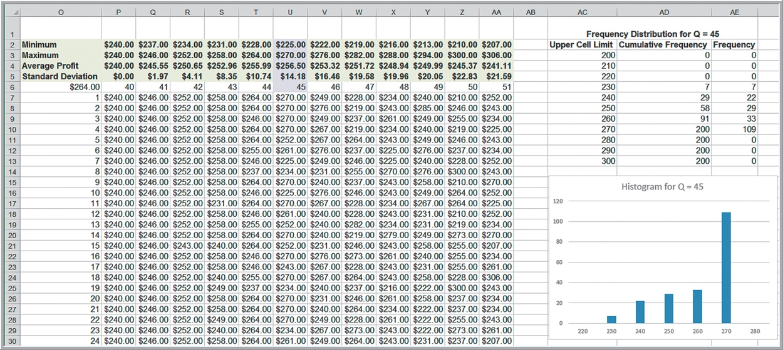
Example 12.14: A Prescriptive Simulation Model for a Single-Period Purchase Decision (3 of 4)
To find the purchase quantity that maximizes the expected profit. Use a two-way data table where the rows represent the simulation trials and the columns correspond to the purchase quantity.

Slide 46
Example 12.14: A Prescriptive Simulation Model for a Single-Period Purchase Decision (4 of 4)
Results:
The largest average profit occurs for a purchase quantity of 45 (which may vary in different simulations).
The range and standard deviation generally increase as the purchase quantity increases, suggesting a higher amount of risk.

Slide 47
Overbooking Decisions
In any realistic situation, the actual customer demand as well as the number of cancellations would be uncertain.
We may use Monte Carlo simulation to help determine the best overbooking policy.

Slide 48
Example 12.15: Monte Carlo Simulation for the Hotel Overbooking Model (1 of 2)
Hotel Overbooking Simulation Model
Assumptions:
Customer demand is normally distributed with a mean of 320 and standard deviation of 15.
The probability that any reservation is cancelled is 0.04.
Then the number of cancellations is a binomial random variable, with n = number of reservations made, and p = 0.04.

Slide 49
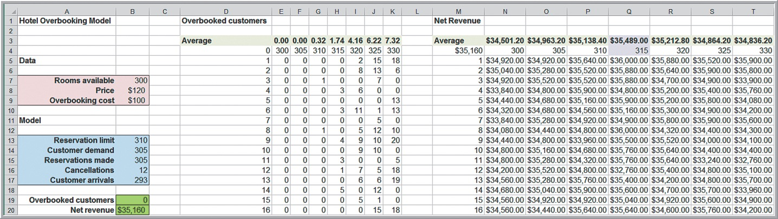
Example 12.15: Monte Carlo Simulation for the Hotel Overbooking Model (2 of 2)
Simulation results
The average net revenue is maximized when 315 reservations are taken; that is, overbooking the hotel by 15 rooms, resulting in an average of 1.74 overbooked customers.

Slide 50
Project Management
For many real projects, activity times are random variables. In most cases, times must be estimated judgmentally, so we often assume that they have a triangular distribution.
Portion of Table 12.1 with uncertain activity times:
Activity | Predecessors | Minimum Time (days) | Most Likely Time (days) | Maximum Time (days)
A Select steering committee | - | 15 | 15 | 15
B Develop requirements list | - | 40 | 45 | 60
C Develop system size estimates | - | 10 | 14 | 30
D Determine prospective vendors | - | 2 | 3 | 5
E Form evaluation team | A | 5 | 7 | 9

Slide 51
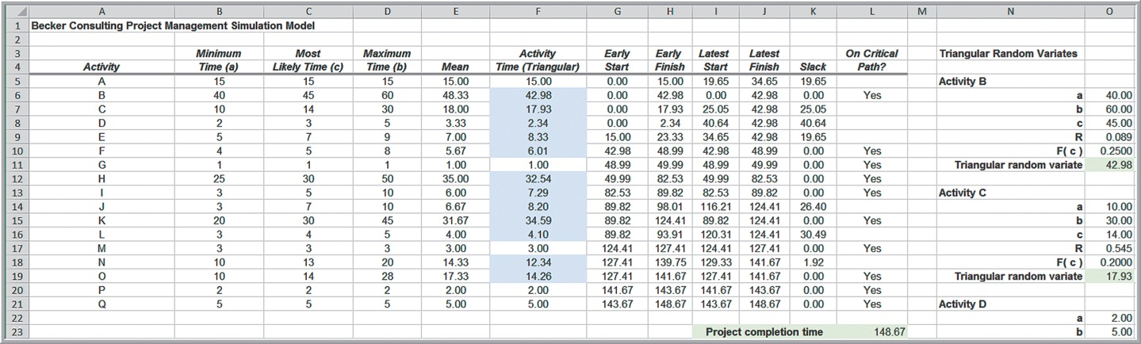
Example 12.16: A Spreadsheet Simulation Model for Project Management (1 of 2)

Slide 52
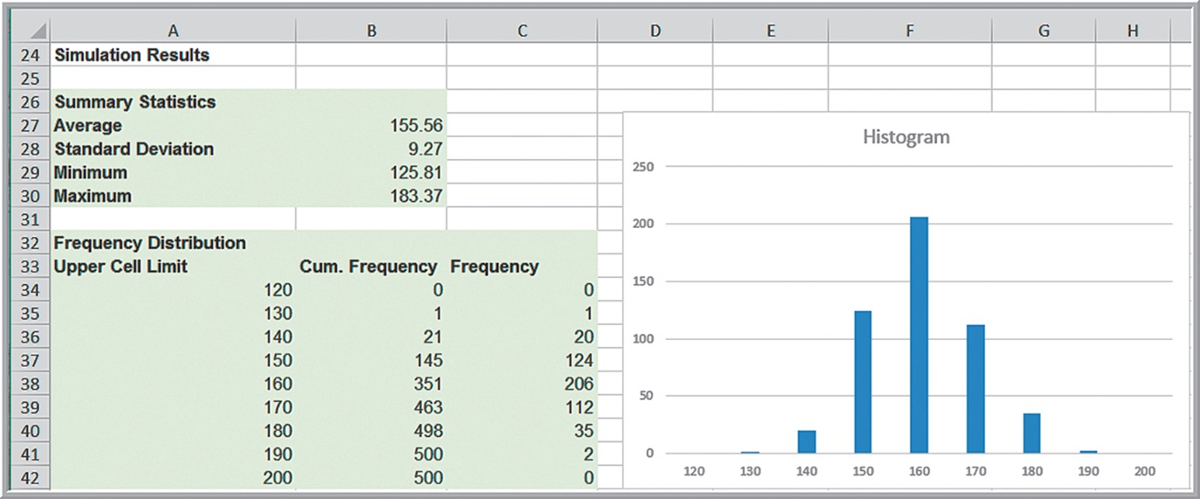
Example 12.16: A Spreadsheet Simulation Model for Project Management (2 of 2)
Simulation results for project completion time

Slide 53
Dynamic Systems Simulation
Dynamic systems involve processes that consist of interacting events occurring over time.
Waiting line systems
Inventory management systems
Production systems
Dynamic system simulation models allow us to draw conclusions about the behavior of a real system by studying the behavior of a model of the system.

Slide 54
Modeling Dynamic Systems
More difficult than just replicating spreadsheets using Monte Carlo simulation, primarily because the logical sequence of events over time must be explicitly taken into account

Slide 55
Example 12.17: A Production/Inventory Simulation (1 of 4)
Planned production capacity for one component is 100 units per shift, and the plant operates one shift per day.
Demand fluctuates and is historically between 80 and 130 units per day (discrete uniform distribution).
Run a second shift the next day if inventory falls to 50 or below at the end of a day.
How many additional shifts will be needed?

Slide 56
Example 12.17: A Production/Inventory Simulation (2 of 4)
Model development:
Ending Inventory = Beginning Inventory + Production - Demand
Simulate 260 working days (one year) and count the number of additional shifts that are required.
Use
to model demand and an IF
function to determine if an additional shift is scheduled.

Slide 57
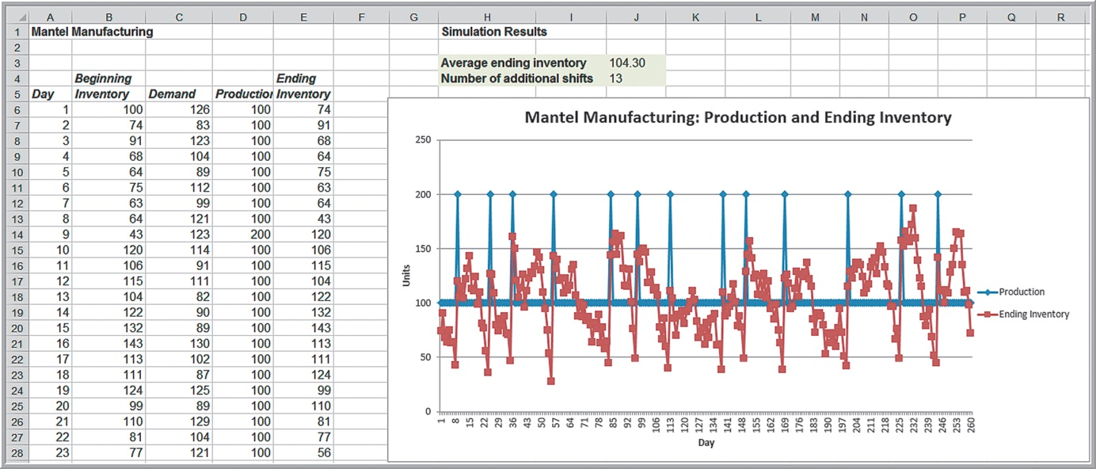
Example 12.17: A Production/Inventory Simulation (3 of 4)
One year simulation model

Slide 58
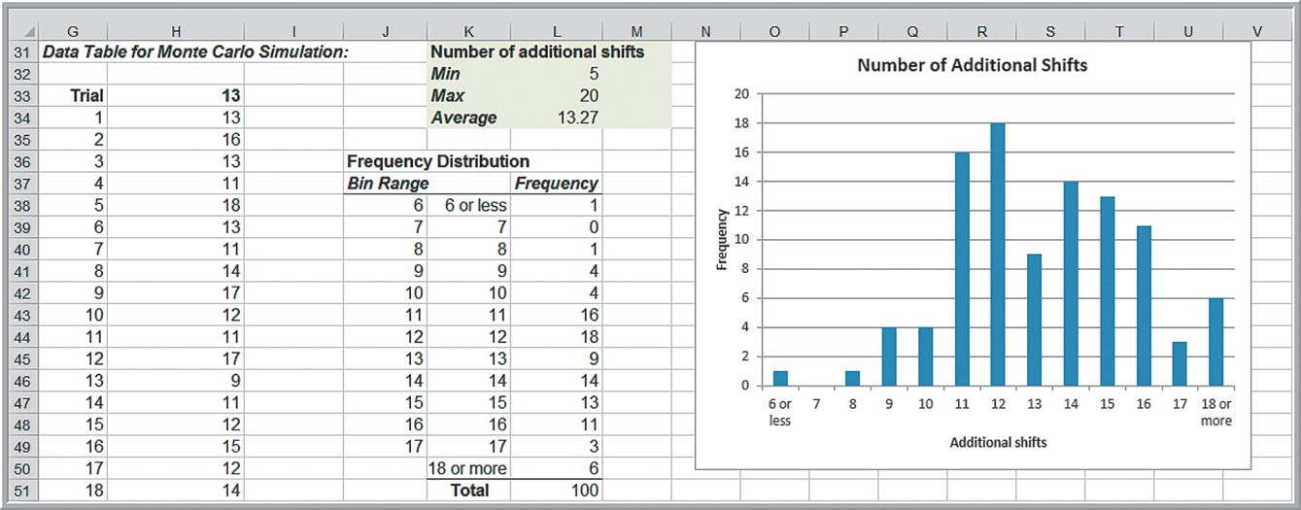
Example 12.17: A Production/Inventory Simulation (4 of 4)
Monte Carlo simulation for number of additional shifts

Slide 59
Simulating Waiting Lines
Simulation logic
Customer arrives.
Customer waits for service if the server is busy.
Customer receives service.
Customer leaves the system.

Slide 60
Key Observations (1 of 2)
If a customer arrives at time t and the server is not busy, then that customer can begin service immediately upon arrival.
If a customer arrives at time t and the server is busy, then that customer will begin service at the time that the previous customer completes service (which will be greater than t). The waiting time is the difference between the time service begins and the arrival time.
In either case, the time at which a customer completes service is computed as the time that the customer begins service plus the time it takes to perform the service.

Slide 61
Key Observations (2 of 2)
The server idle time is the difference between the arrival time of the next customer and the time at which the current customer completes service, if the arrival time of the next customer is greater than the time at which the current customer completes service; otherwise, the idle time is zero.
To find the number in the queue, we note that when a customer arrives, then all prior customers who have not completed service by that time must still be waiting.

Slide 62
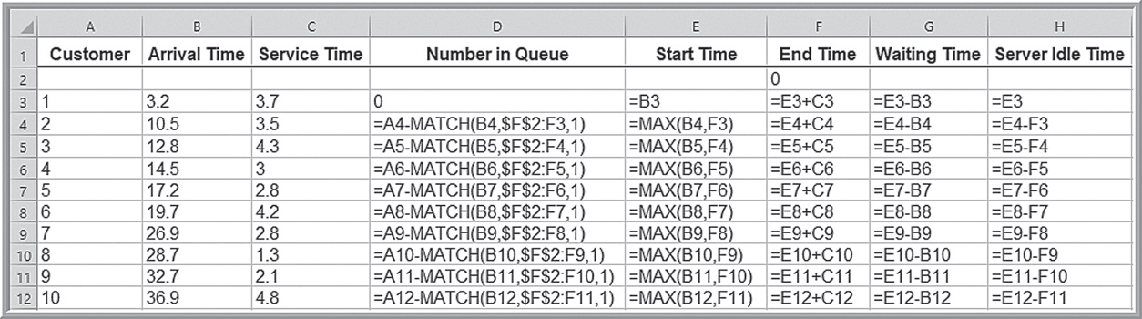
Manual Simulation and Spreadsheet Implementation
Customer | Arrival Time | Service Time | Number in Queue | Start Time | End Time | Waiting Time | Server Idle Time
1 | 3.2 | 3.7 | 0 | 3.2 | 6.9 | 0 | 3.2
2 | 10.5 | 3.5 | 0 | 10.5 | 14 | 0 | 3.6
3 | 12.8 | 4.3 | 1 | 14 | 18.3 | 1.2 | 0
4 | 14.5 | 3 | 1 | 18.3 | 21.3 | 3.8 | 0
5 | 17.2 | 2.8 | 2 | 21.3 | 24.1 | 4.1 | 0
6 | 19.7 | 4.2 | 2 | 24.1 | 28.3 | 4.4 | 0
7 | 26.9 | 2.8 | 1 | 28.3 | 31.1 | 1.4 | 3
8 | 28.7 | 1.3 | 1 | 31.1 | 32.4 | 2.4 | 0
9 | 32.7 | 2.1 | 0 | 32.7 | 34.8 | 0 | 0.3
10 | 36.9 | 4.8 | 0 | 36.9 | 41.7 | 0 | 2.1

Slide 63
Example 12.18: Car Wash Simulation (1 of 2)
Customers arrive randomly between three and eight minutes apart.
A standard wash takes four minutes (the service time), but may run as high as seven minutes.
The probabilities of the times between arrivals and service times are estimated from historical data.

Slide 64
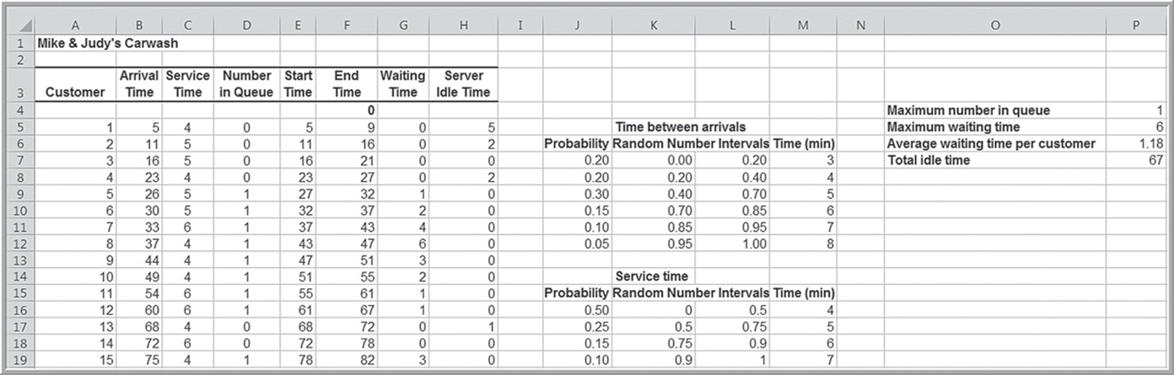
Example 12.18: Car Wash Simulation (2 of 2)
Excel file Car Wash Simulation
This model only simulates one day. Use data tables to find distributions for the performance measures.

